Slide 1

Adventure Works Regional Analysis
This presentation outlines the development and deployment of a Power BI dashboard designed to provide comprehensive regional analysis for Adventure Works. We'll explore the journey from raw data to actionable business insights.

Slide 2
Adventure Works Regional Analysis Dashboard
The Adventure Works Regional Analysis dashboard provides a comprehensive overview of sales performance across multiple countries, including Australia, Canada, France, Germany, the United Kingdom, and the United States. It consolidates key financial metrics such as total sales, total cost, gross profit, and profit margins, allowing for a clear understanding of business performance. The analysis is segmented into Internet Sales and Reseller Sales, offering insights into revenue streams, cost efficiency, and profitability.

Slide 3
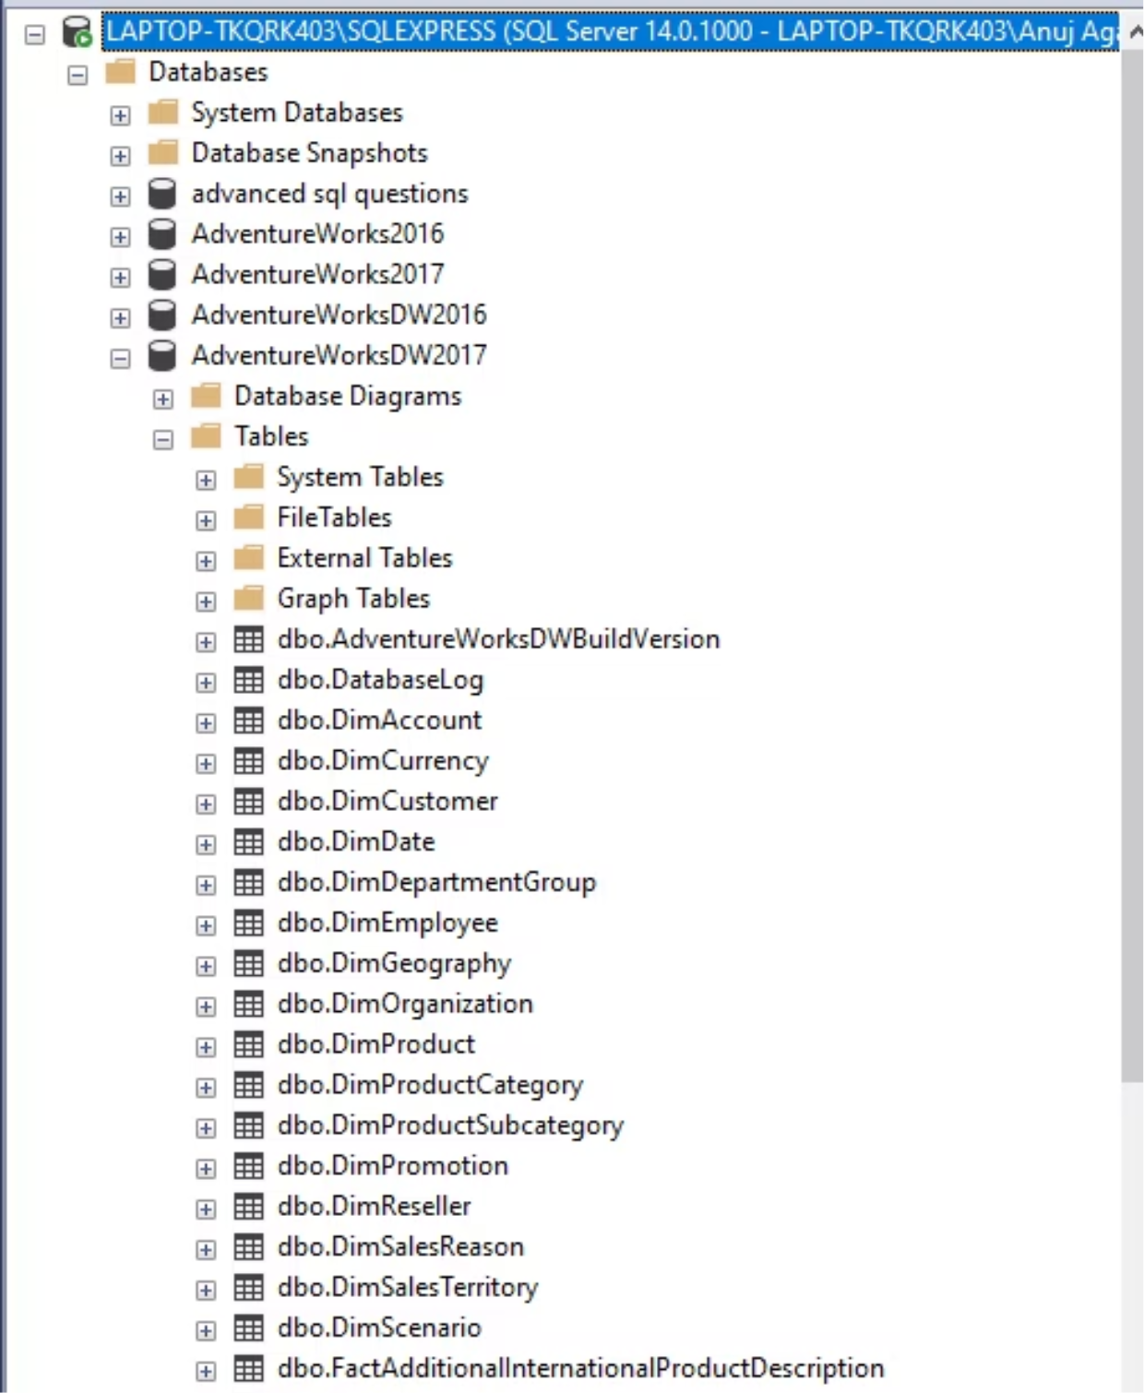
Data Import & Database Connection
MySQL Server Management Studio
. The Data source: Adventure Works database (imported from MySQL Server Management Studio).
Dimension Tables (Descriptive / Lookup Data)
DimCustomer – Contains customer details (e.g., customer name, demographics, location).
DimDate – Calendar table for time-based analysis (day, month, quarter, year).
DimGeography – Location details (city, state, country, region).
DimProduct – Product-level details.
DimProductCategory – Product category (e.g., Bikes, Clothing, Accessories).
DimProductSubcategory – Product subcategory linked to categories.
DimReseller – Information about resellers/distributors.
Fact Tables (Transaction Data)
FactInternetSales – Internet-based sales transactions (contains keys linking to dimensions, sales amount, cost, profit).
FactResellerSales – Reseller sales transactions with similar metrics

Slide 4
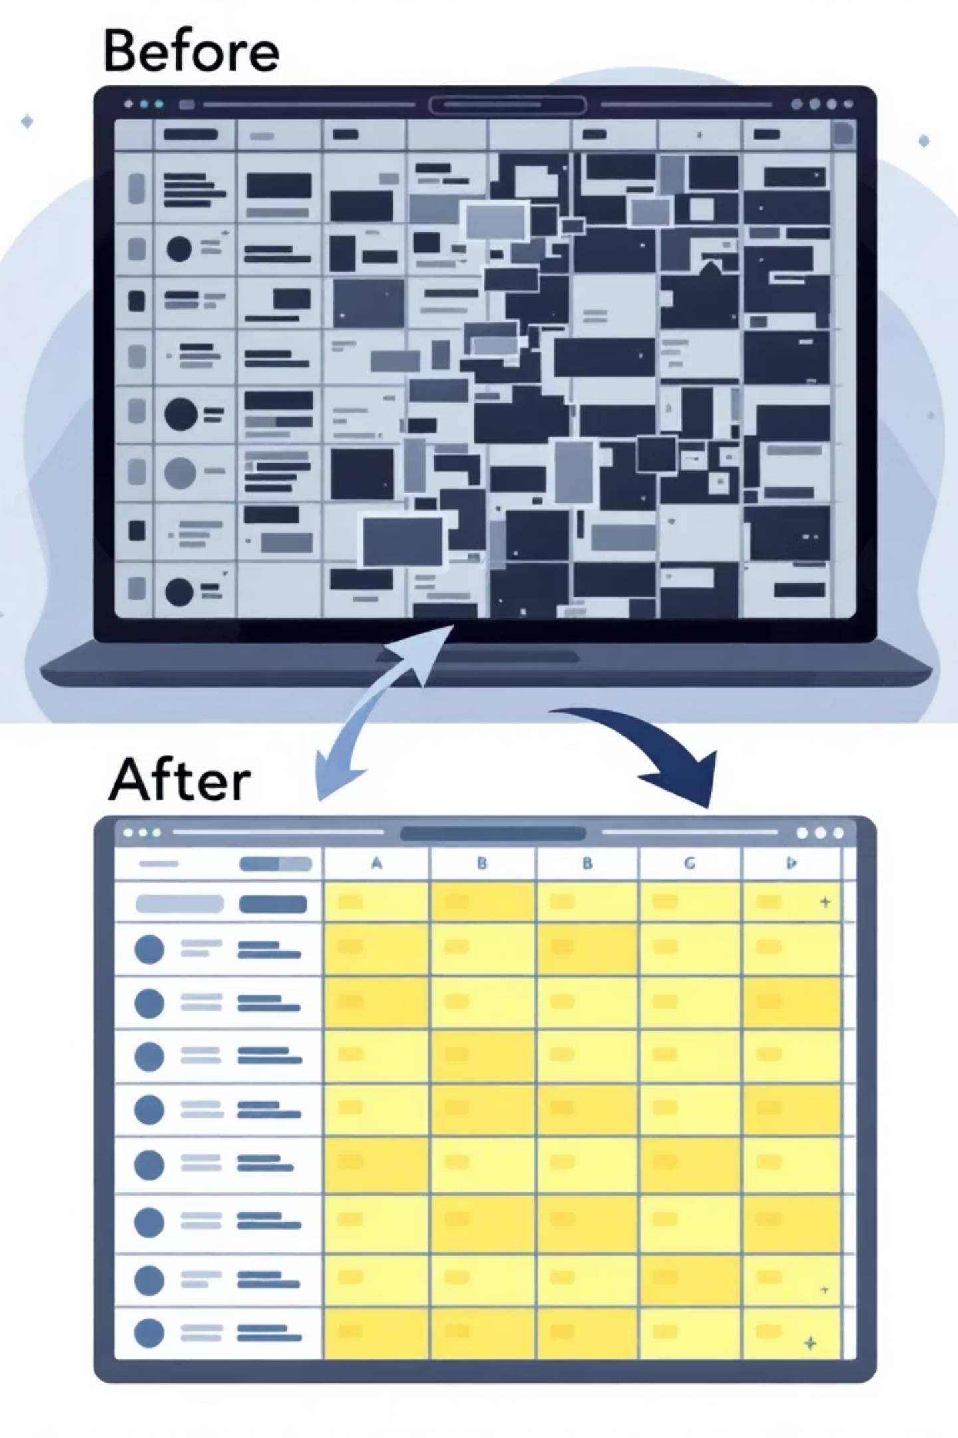
Data Cleaning & Preparation
Check Data Types
Ensure dates are in date format (not text).
Convert numeric fields like Sales Amount, Cost, Profit to decimal/currency format
Handle Missing/Null Values
Replace nulls in geography fields (State, Country) with “Unknown”.
For numeric fields (SalesAmount, UnitPrice, OrderQuantity), replace nulls with 0
Remove Duplicates
Check for duplicate rows in fact tables (FactInternetSales, FactResellerSales).
Create Date Table (DimDate)
Build a proper calendar table with Year, Quarter, Month, Week, Day.
Mark it as a Date Table in Power BI for time intelligence functions (YTD, PY, MTD)

Slide 5
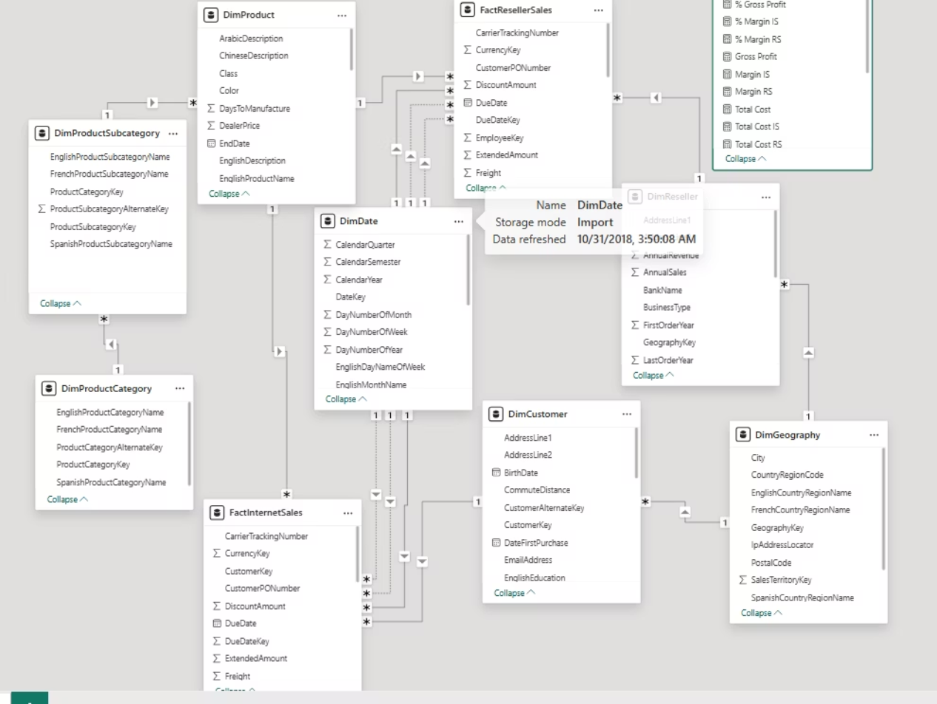
Data Modeling & Relationships
Created a Star Schema model:
Fact Tables → Internet Sales, Reseller Sales.
Dimension Tables → Date, Customer, Product, Geography, Reseller.
Defined active & inactive relationships.
Built a semantic model for analysis.

Slide 6

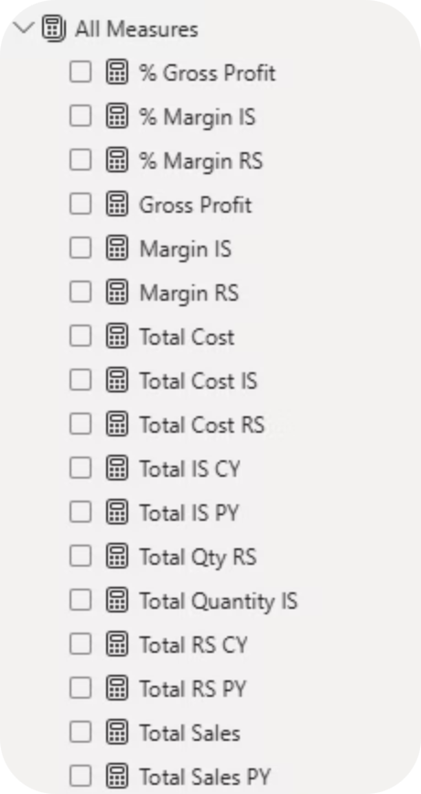
DAX Measures & Calculations
Core Financial Metrics
Time Intelligence Functions
Total Sales, Total Cost, Gross Profit
SAMEPERIODLASTYEAR for YoY comparisons
% Gross Profit and % Margin calculations
Current Year (CY) vs Previous Year (PY)
Channel-specific measures (IS/RS)
CALCULATE for filtered calculations
Advanced Operations
SUM, DIVIDE for aggregations
Complex conditional logic
Cross-table calculations
Created 18 comprehensive DAX measures including Total Sales, Margin calculations for Internet Sales (IS) and Reseller Sales (RS), year-over-year comparisons, and percentage-based KPIs. These measures form the analytical foundation enabling dynamic calculations across all visualizations and providing consistent business metrics throughout the dashboard.

Slide 7

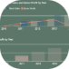
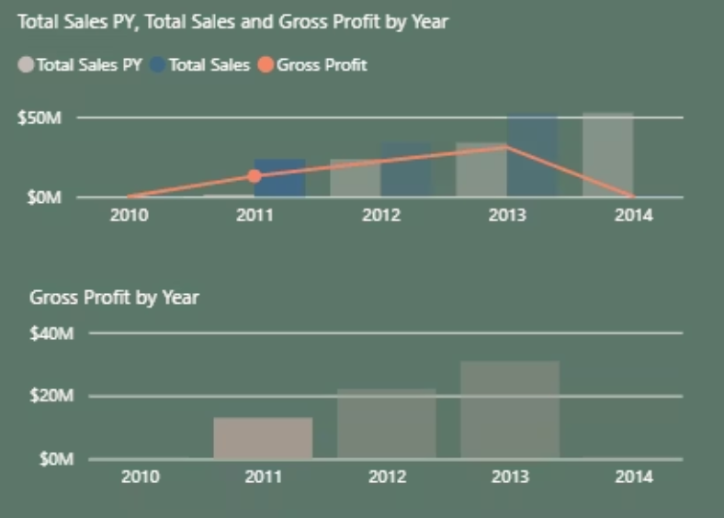
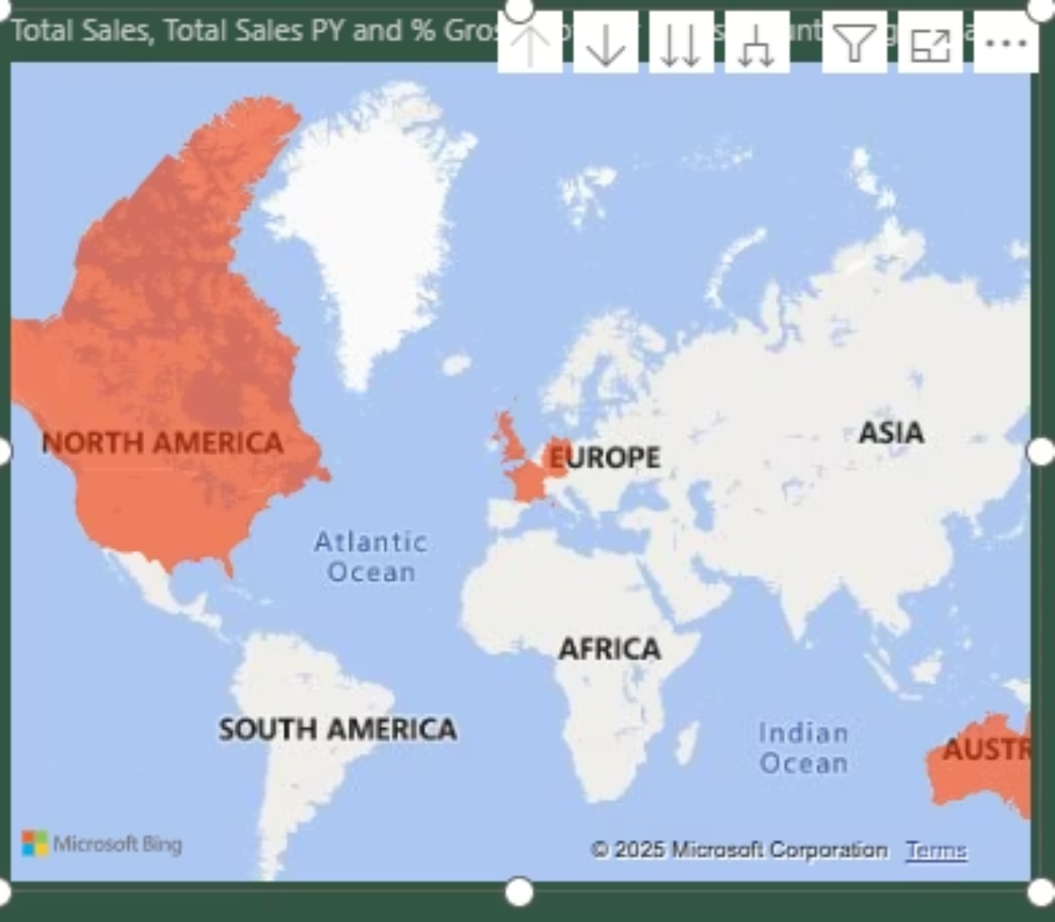
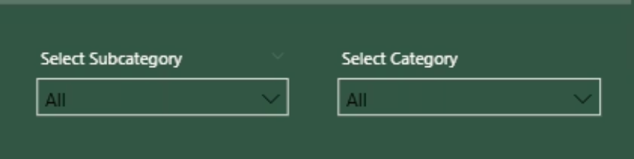
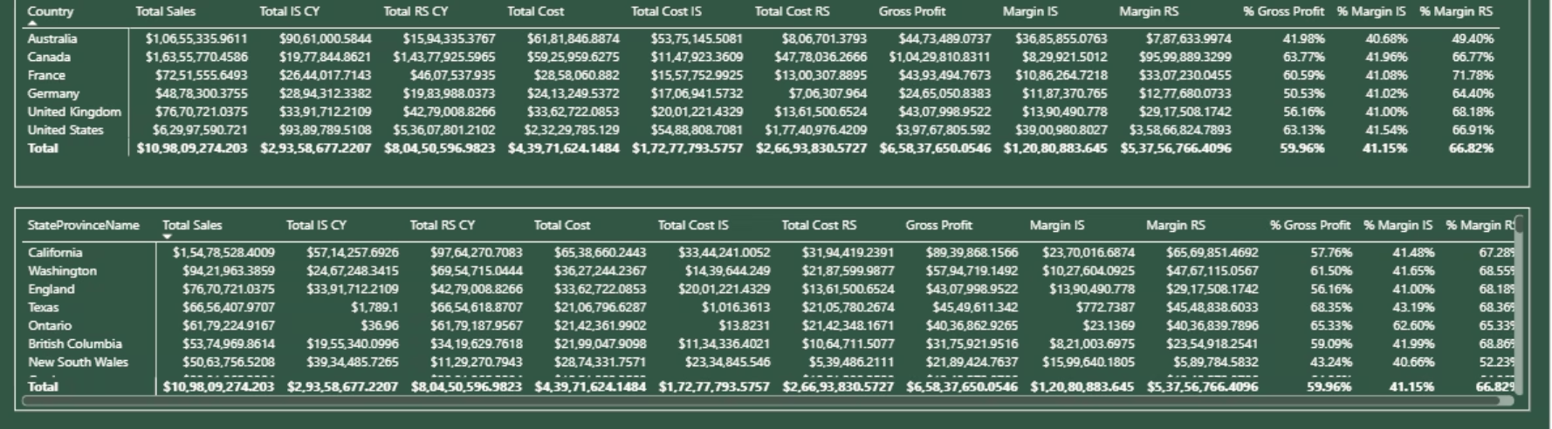
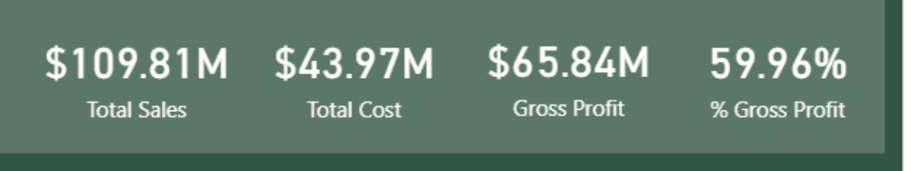
Visualization Tools & Techniques
Interactive Filters
Used Power BI visuals for insights:
Card visuals – KPIs (Sales, Profit, Margin).
Dropdown filters – Product Category & Subcategory.
Matrix – Sales by region & product.
Line & Clustered Column charts – Trends.
Filled Map – Geographic hotspots.
Drill-through for detailed analysis.
Optimized → Reduced model size & improved interactivity.

Slide 8


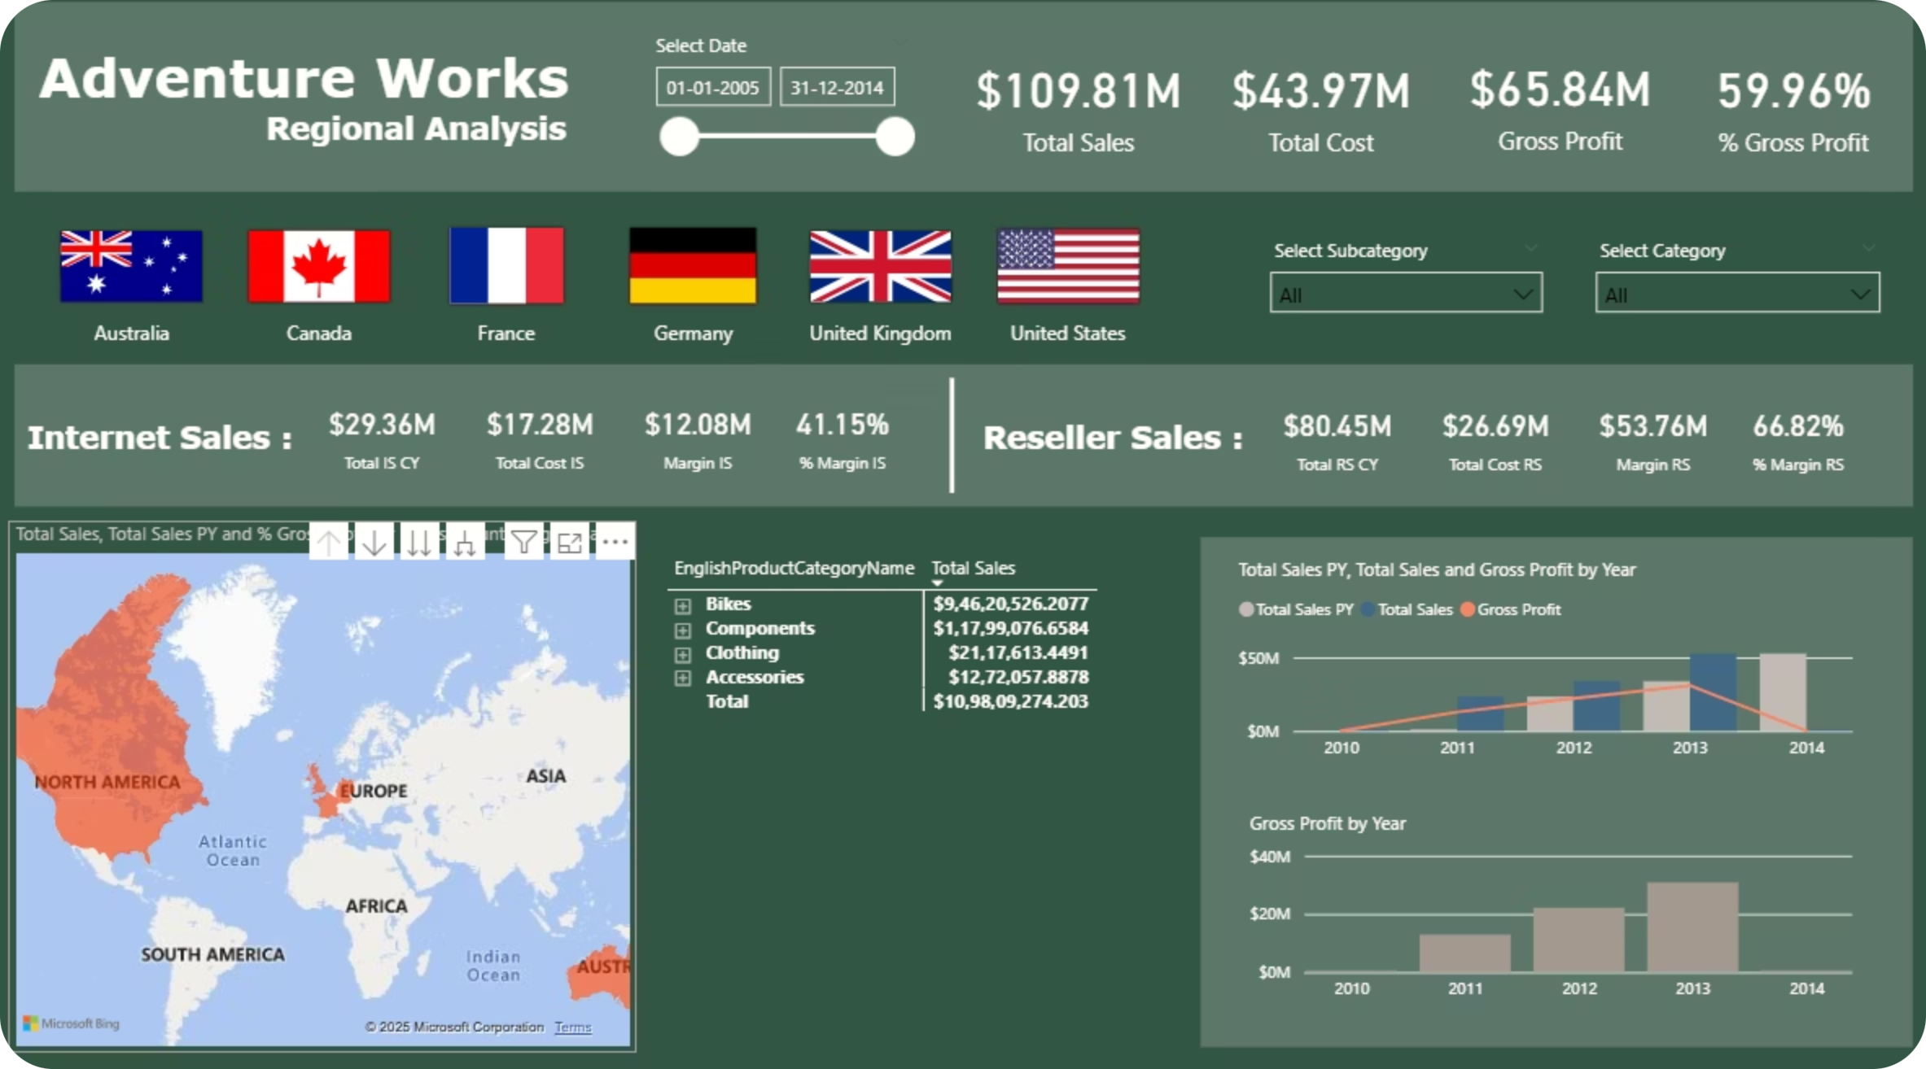


Dashboard Features & Functionality
Model Size Optimization
Reduced model size through data compression and optimization techniques, improving performance and reducing memory usage while maintaining full analytical capability.
Drill-Through Functionality
Implemented drill-through capabilities allowing users to navigate from summary views to detailed analysis, providing seamless exploration from high-level KPIs to granular data insights.
Interactive Visualizations
Created fully interactive visualizations with cross-filtering capabilities, enabling users to click on any chart element to filter related visuals and discover data relationships dynamically.

Slide 9
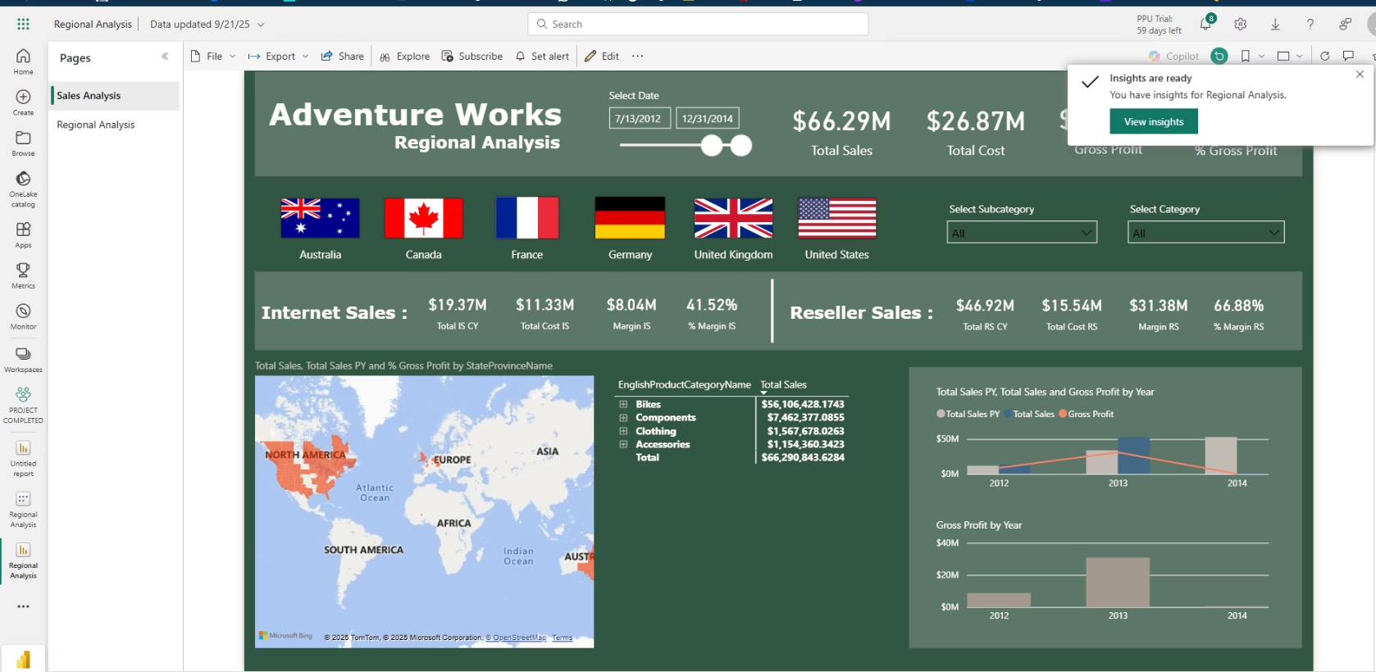
Power BI Service Deployment
Service Publishing
Successfully published the Adventure Works dashboard to Power BI Service, making it accessible to stakeholders across the organization. The deployment includes automated data refresh capabilities and proper security configurations for controlled access.
Created a comprehensive dashboard combining multiple report pages into a unified executive view, featuring the most critical KPIs and trends for quick decision-making. The service deployment enables mobile access and sharing capabilities for business users.
Live Dashboard Access: The interactive dashboard is available through Power BI Service, providing real-time access to Adventure Works analytics with full interactivity and drill-down capabilities for comprehensive business intelligence.
Access the Live Dashboard here.
GitHub Repository: Explore the project's source code and files on GitHub.
Access the GitHub Repository here.

Slide 10


Business Impact & Key Insights
2
18
100%
Dashboard Pages
DAX Measures
Interactive
📊 Business Insights
Reseller Sales dominate overall revenue
Reseller Sales ($80.45M) contribute nearly 73% of total sales, while Internet Sales ($29.36M) make up only about 27%. This shows the company is more dependent on resellers than direct online channels.
Higher profitability in Reseller Sales
Reseller Sales have a 66.82% gross margin, compared to 41.15% gross margin in Internet Sales. This indicates that reseller channels are more cost-efficient and deliver stronger profitability.
Steady sales growth from 2010 to 2013
The trend chart shows continuous growth in total sales and gross profit until 2013, highlighting business expansion during that period. However, 2014 shows a slight decline in gross profit, which could signal rising costs or market pressure.
Product categories driving revenue
Bikes ($946M) and Components ($1.17B) generate the majority of sales, while Clothing and Accessories contribute significantly less. This indicates a heavy reliance on the biking segment, which may present both strengths (market leadership) and risks (lack of diversification).
Regional concentration in North America and Europe
The map visualization highlights that most sales come from North America and Europe, with limited presence in Asia, Africa, and South America. This suggests potential opportunities for geographic expansion into underpenetrated markets.
Profitability gap between channels
While total Internet Sales and Reseller Sales differ widely, gross profit contribution from resellers is far stronger. Focusing more on reseller partnerships or optimizing online sales margins could boost profitability further.
Gross Profit peaked in 2013
Gross Profit reached nearly $35M in 2013, but then dropped in 2014, even though sales stayed high. This could indicate cost increases, pricing challenges, or discounts impacting margins.

Slide 11
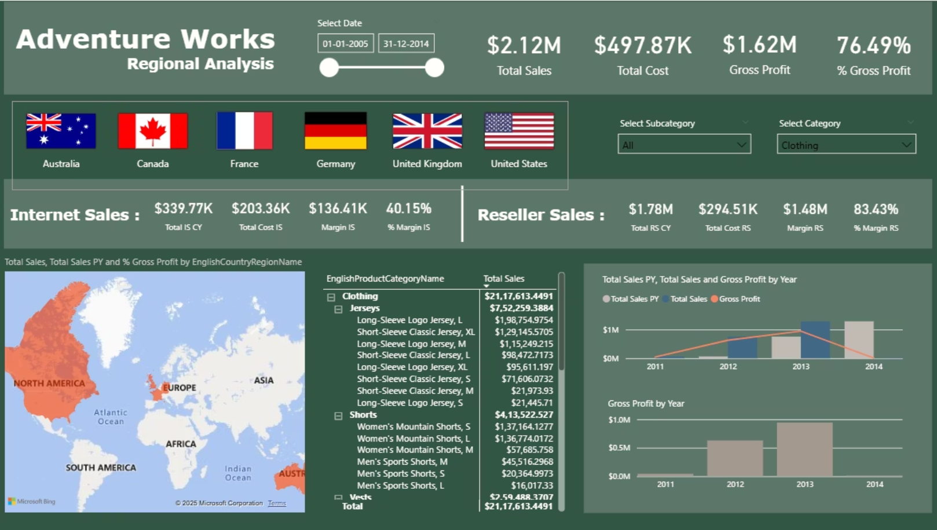
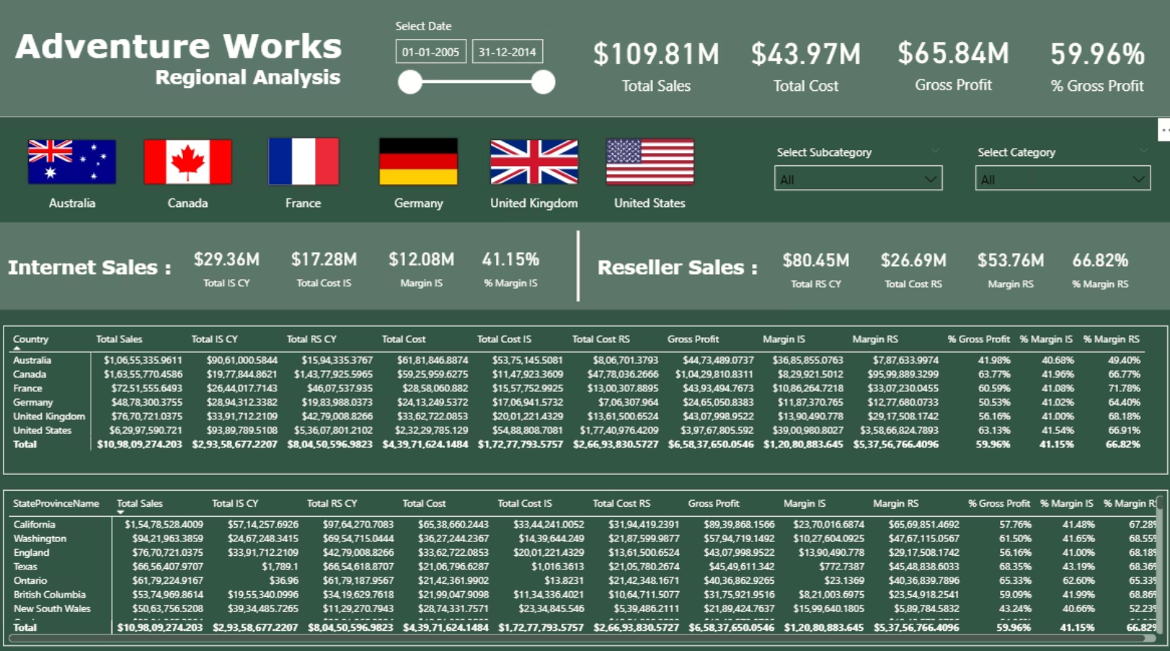
Thank You
Special thanks to Divakar Kushwaha Sir for his guidance and assistance throughout this project.

